Slide 1




RedHat
Tribe Members:
Jhansi Saketa
M. Debasis Behera
Pranjali Gupta
Aryaman LaL

Slide 2
RedHat
Problem statement :
To create a dynamic and configurable ETL framework that would reduce the creation and modification in an ETL job.
Requirements:
The basic need to be satisfied by this project is to automate the process of extracting the quarterly information from Empirical model sheets and Regression Model sheets of each client data excel into the consolidated excel document in the specified format. This activity is currently a monthly activity.

Slide 3
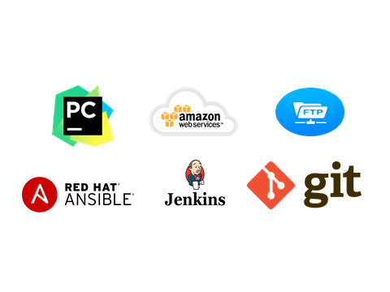
RedHat
SOFTWARE REQUIREMENT

Slide 4
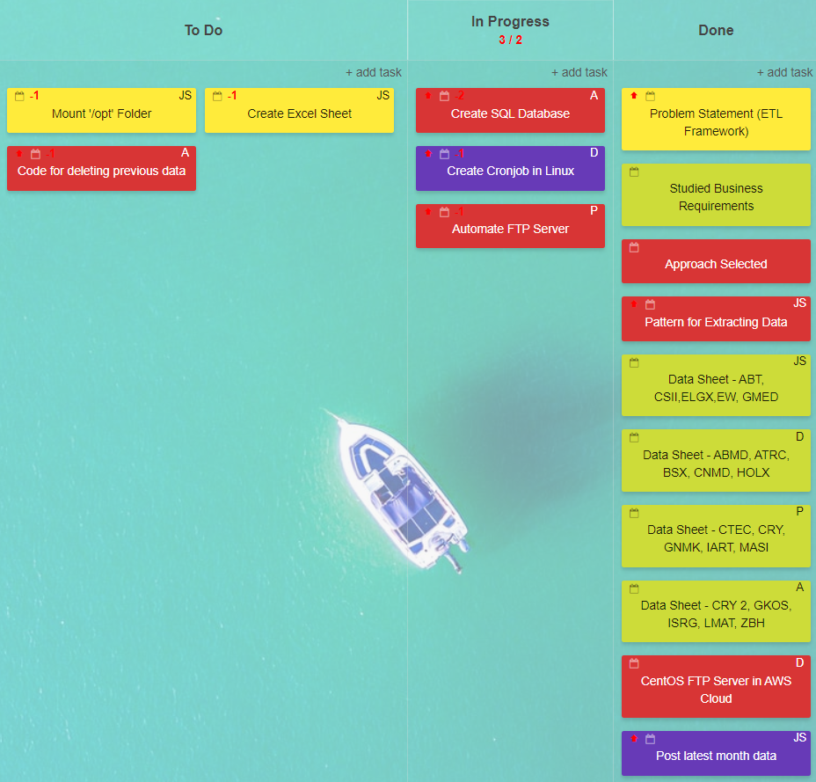
RedHat
DASHBOARD

Slide 5
RedHat
Lets have a look
Lets have a look

Slide 6

RedHat
THANK YOU

